Slide 1



NEXT GEN EMPLOYABILITY PROGRAM
Creating a future-ready workforce
Team Members
College Name
Student Name : Naveenkumar D
Student ID : au422721104029
v.r.s college of engineering & technology

Slide 2
CAPSTONE PROJECT SHOWCASE
Project Title
Car Rentals Application with Django Framework
Abstract | Problem Statement | Project Overview | Proposed Solution | Technology Used | Modelling & Results | Conclusion

Slide 3

Abstract:
The goal of the Django and Python-developed Car Rental Application is to make handling car rentals easier for administrators and clients alike. Customers may easily browse, choose, and reserve rental cars using this web-based platform, while administrators can effectively manage inventory, reservations, and client information.

Slide 4
Problem statement:
As a result, this issue is addressed by the creation of a Car Rental Application that makes use of Django and Python to offer an extensive and intuitive platform for renting cars. Through process automation, improved user interface, and strong backend features, this solution seeks to transform the way rental companies run, guaranteeing accuracy, efficiency, and client happiness.

Slide 5
Project overview:
The goal of the proposed project is to use Django and Python to create a comprehensive car rental application that will meet the needs of rental business administrators and customers alike. In addition to giving a user-friendly interface for browsing, booking, and maintaining reservations, the application will expedite the rental car process and provide comprehensive backend functions for inventory management and analytics.
.

Slide 6
Proposed solution
User Authentication and Authorization:
Vehicle Inventory Management:
Customers can create accounts securely, log in, and manage their profiles.
Administrators can add, edit, and remove vehicles from the inventory database.
Reservation System:
Booking Management:
Customers can search for available vehicles based on criteria such as location, date, and vehicle type.
Customers can view their booking history, upcoming reservations, and payment status.

Slide 7
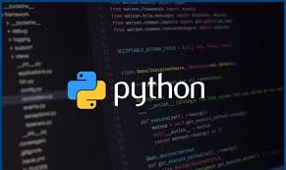
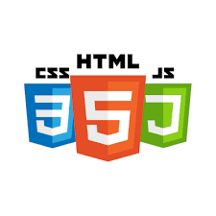

Technology used

Slide 8
Modelling and Result
In developing a car rental application with the Django framework, the process typically begins by defining the models that represent the core entities of the system. For instance, you'd create a Car model to store details like make, model, year, and price per day.
Additionally, a Rental model would be necessary to manage rental transactions, associating rented cars with users, recording rental periods, total costs, and tracking whether the car has been returned. After establishing the models, the next steps involve creating views and templates to handle user interactions, such as browsing available cars, renting vehicles, and managing rental transactions.

Slide 9
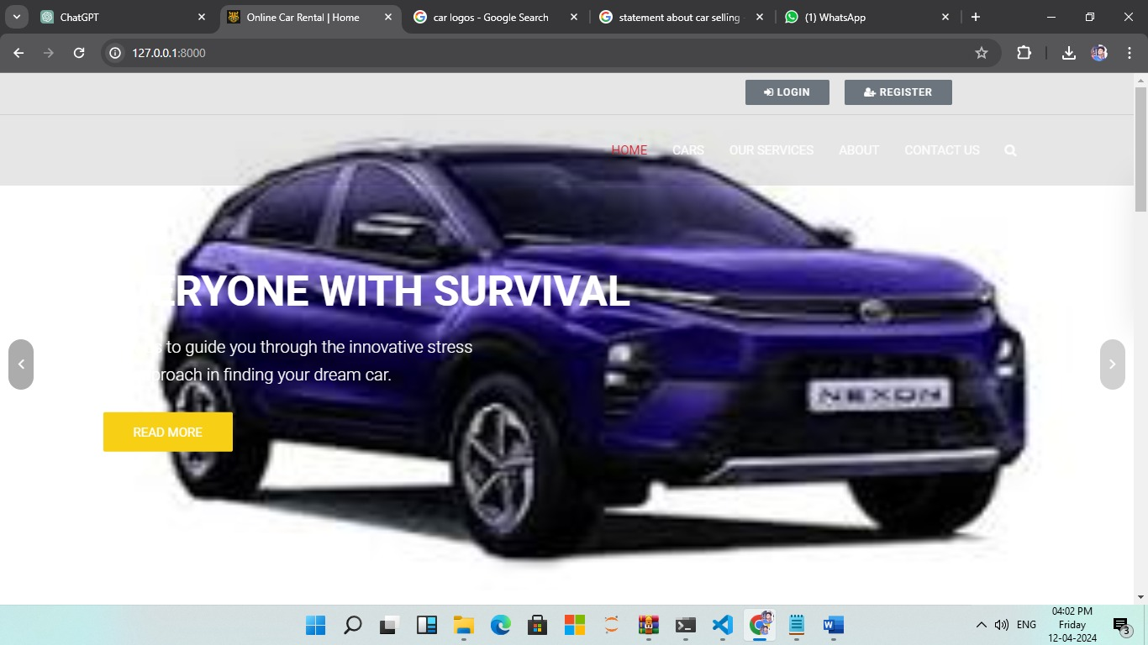
Homepage

Slide 10
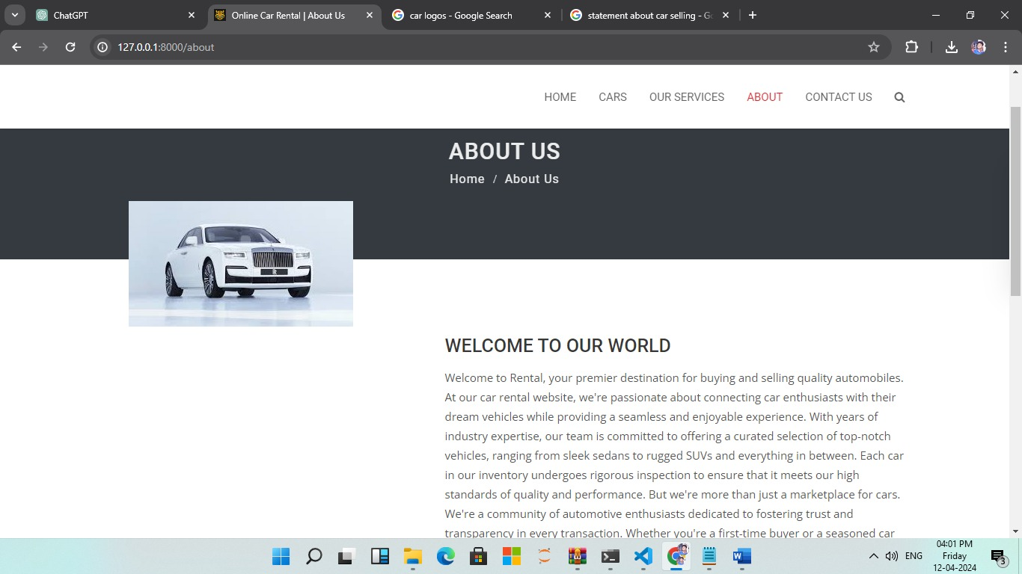
About us page

Slide 11
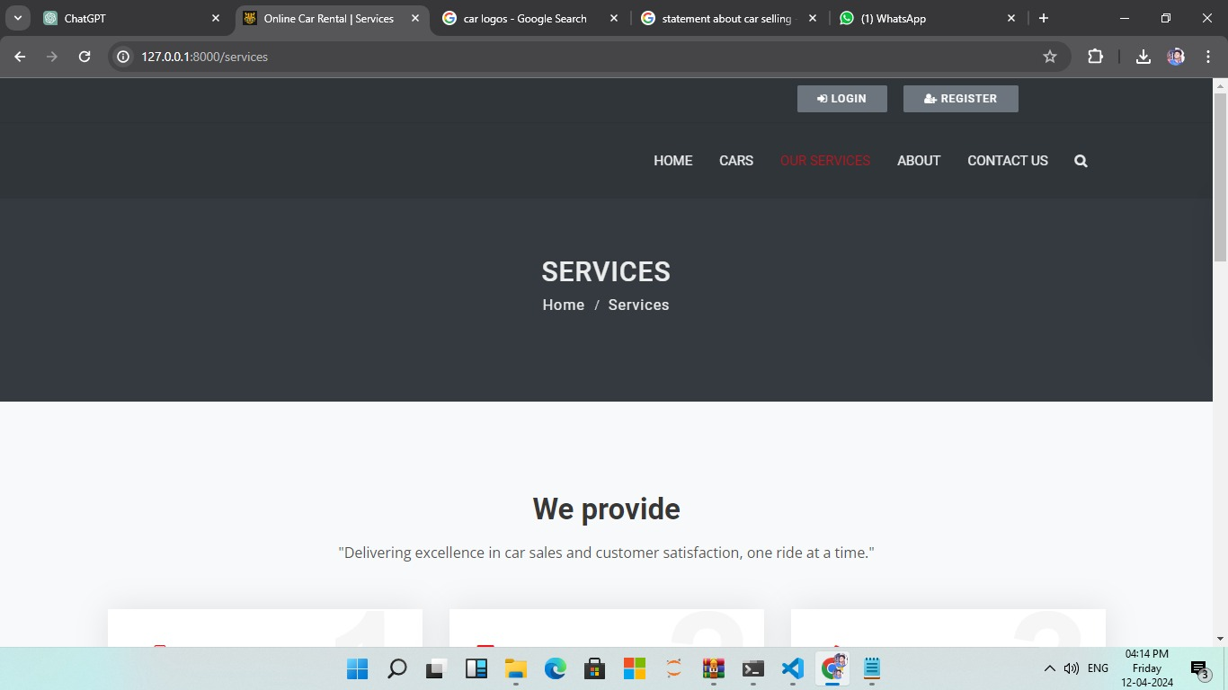
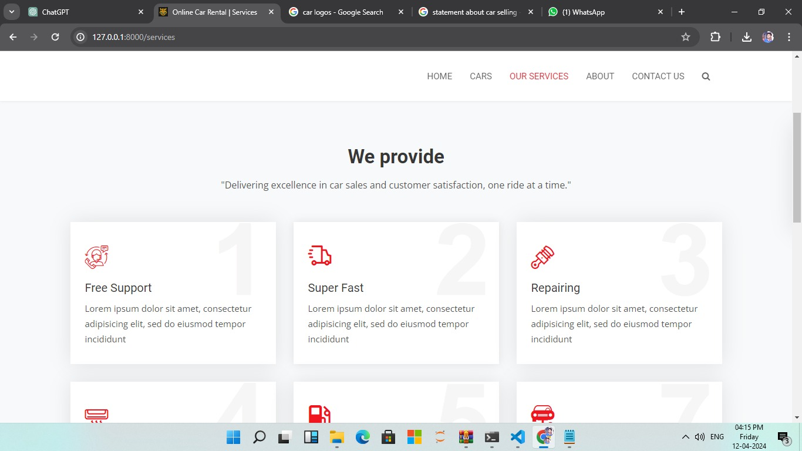
Service page

Slide 12
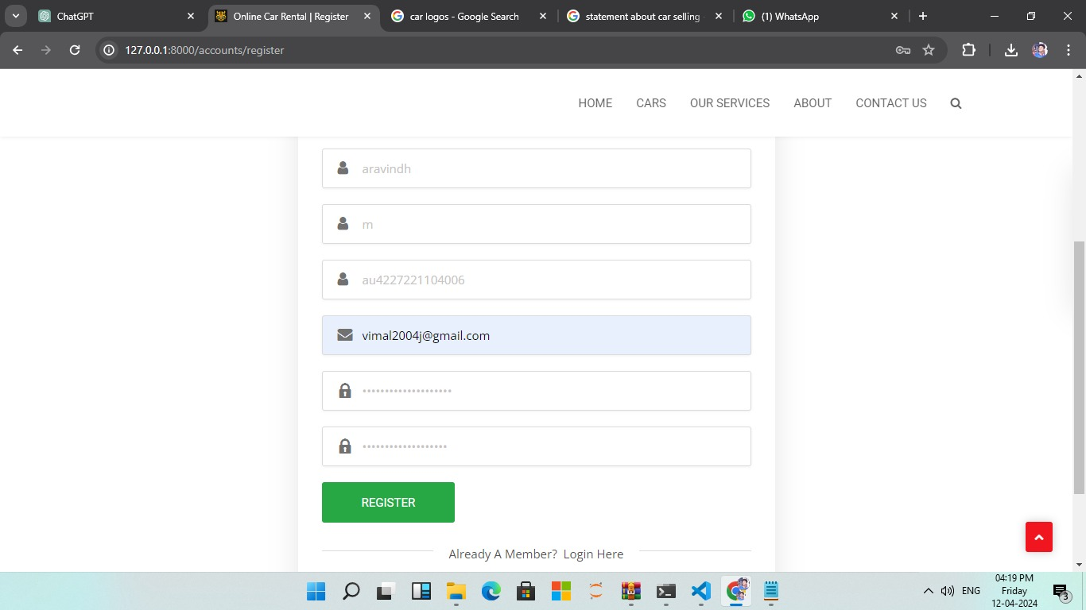
login page

Slide 13
Future enhancements
In future engagements with the Django framework for your car rental application, there's an array of avenues to explore for refining and expanding the system. One significant area of focus could be enhancing the user experience to ensure seamless interaction with the platform. This involves implementing responsive design principles to accommodate users across various devices, coupled with accessibility enhancements to cater to a diverse user base.
Additionally, refining the search and filtering functionalities can empower users to quickly find the perfect rental vehicle by integrating advanced search options like faceted search and keyword search. Moreover, implementing dynamic pricing strategies, such as demand-based pricing and long-term rental discounts, can optimize revenue generation while attracting more customers. .

Slide 14
conclusion
In conclusion, developing a car rental application with the Django framework offers immense potential for providing users with a seamless and efficient rental experience. By leveraging Django's powerful features for model definition, views, and templates, you can create a robust system capable of managing rental transactions, user accounts, and inventory seamlessly. The application can be enhanced further by focusing on aspects such as user experience improvements, advanced search and filtering capabilities, dynamic pricing strategies, integration with payment gateways, and ongoing maintenance.

Slide 15
Thank you

